Slide 1
SAP Application Development
Adrian Streitz, Johannes Rank, Borys Levkovskyi

Slide 2
Prerequisites
Fundamental programming skills
Recommended: Experience in software development with Eclipse

Slide 3
Agenda
Application development with SAP
Technical basis
Introduction to SAP GUI
Introduction to ABAP for Eclipse
Setting up the development environment

Slide 4
I. Application Development with SAP Introduction
SAP is one of the largest providers of enterprise applications worldwide
SAP software is highly customizable on individual business processes
SAP offers different possibilities to extend its software and develop own applications based on its infrastructure
The core of application of programming in SAP is the proprietary programming language called ABAP
But: current trends lead to an increasing demand for web-based and mobile applications
New SAP technologies provide the possibility to react to new trends and still be compatible with the existing solutions

Slide 5
I. Application Development with SAP Application program types
Type | Description | Programming languages
Report | Executable programs Processing and displaying of data | ABAP
Dynpro | Application programs with user interface within SAP GUI Handling user interaction with SAP GUI | ABAP
Business Server Pages | Web-based applications Creating HTML pages with ABAP | HTML, HTMLB, ABAP
Web Dynpro | Web-based applications Creating web pages solely with ABAP | ABAP
SAPUI5 | Web and mobile applications Focus on increased usability | HTML5, JavaScript, ABAP

Slide 6
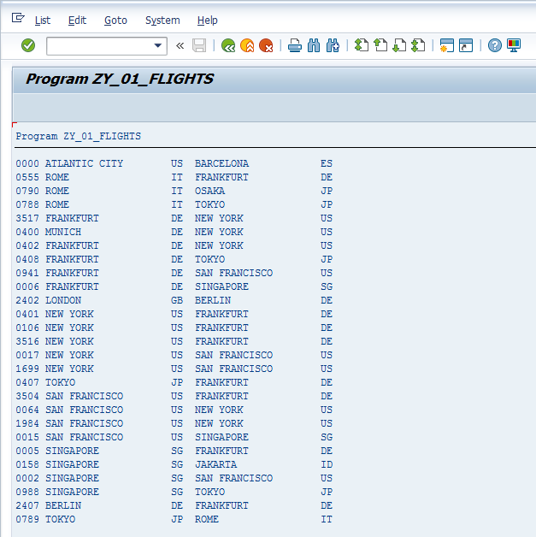
I. Application Development with SAP Report

Slide 7
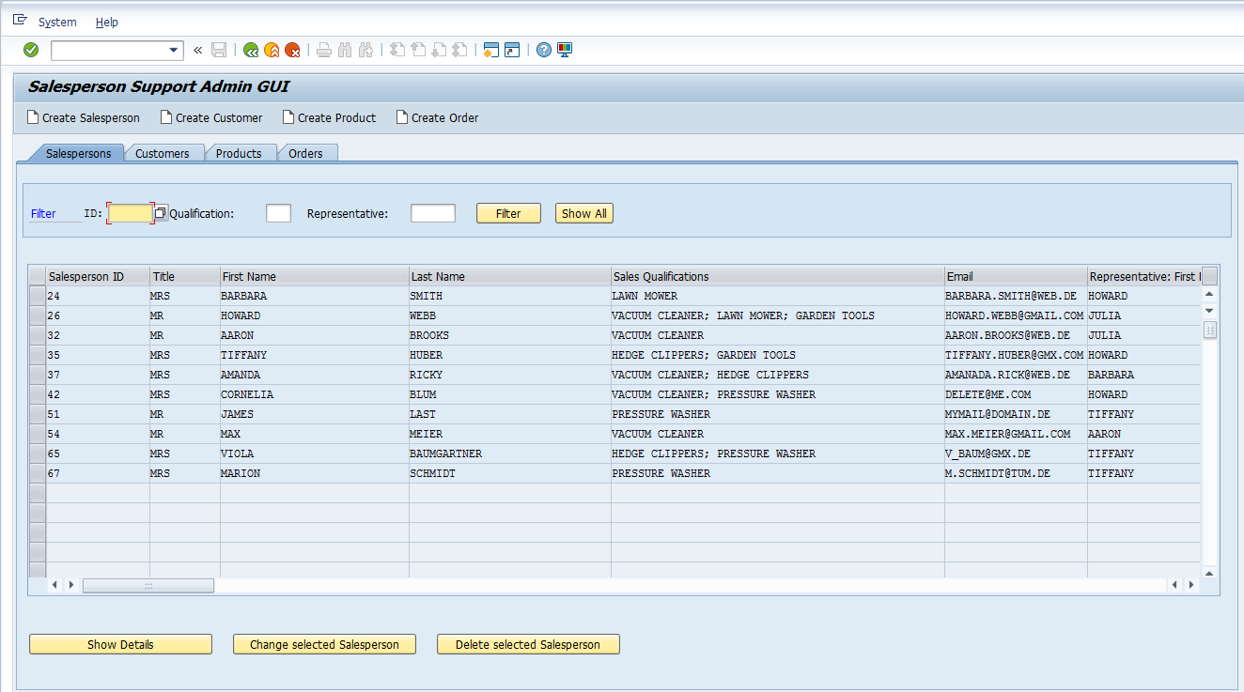
I. Application Development with SAP Dynpro

Slide 8
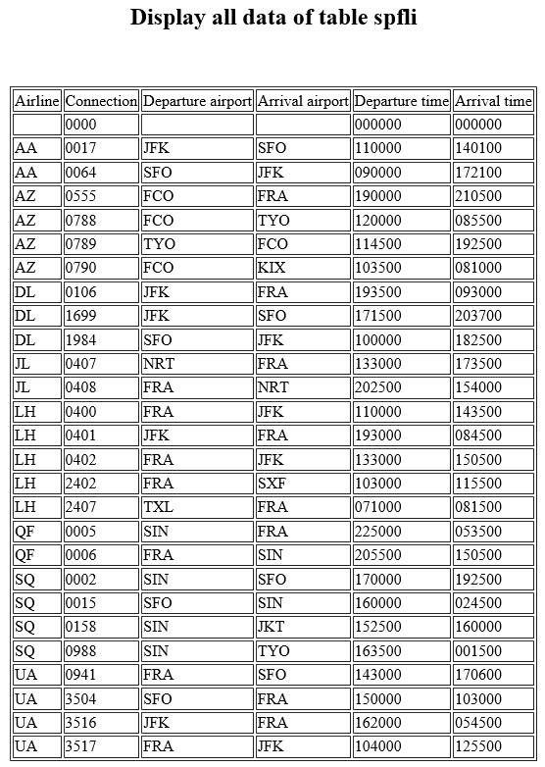
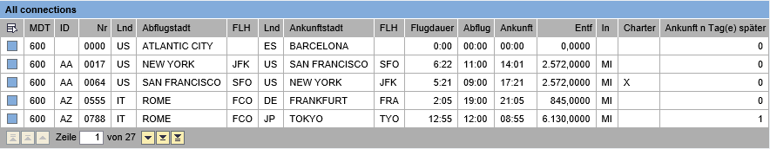
I. Application Development with SAP Business Server Pages

Slide 9
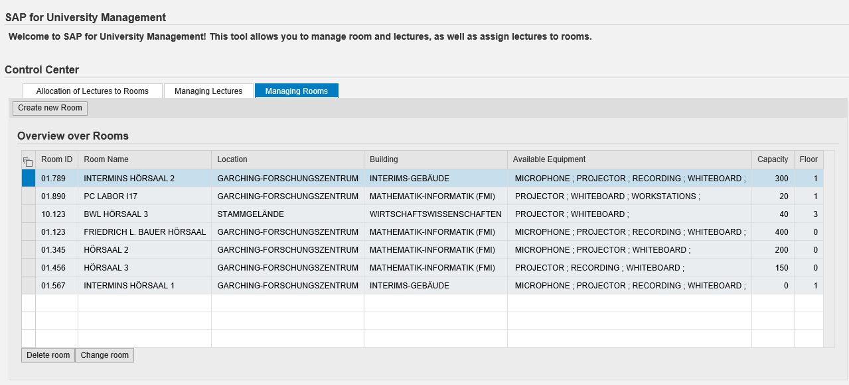
I. Application Development with SAP Web Dynpro

Slide 10
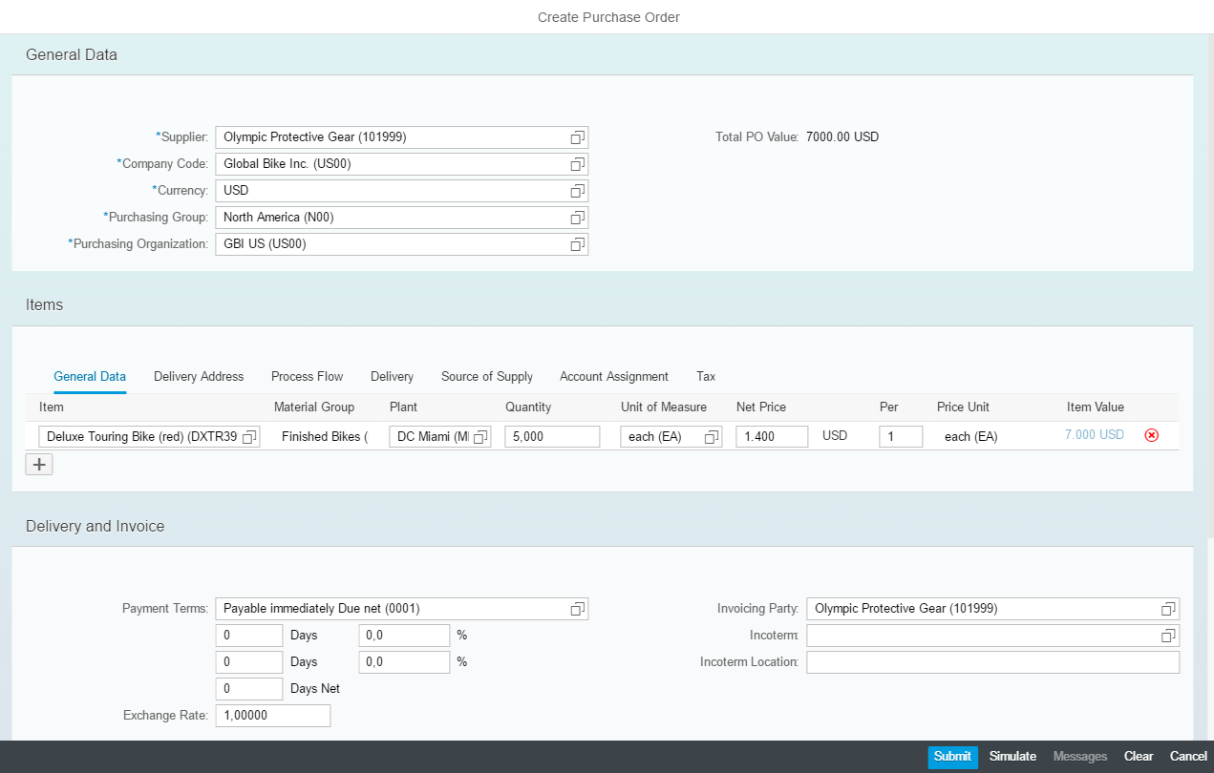
I. Application Development with SAP SAPUI5

Slide 11
II. Technical Basis SAP system architecture
Presentation
SAP GUI
SAP GUI
Web
Mobile
…
Application
Application Server
Application Server
…
Data
DB
…
DB
…
DB

Slide 12
III. Introduction to SAP GUI About the SAP GUI
User interface for system interaction
SAP GUI is offered on different platforms
Windows (most popular)
Java Environment
HTML
All three offer the same basic functionality, but the Windows client is recommended by SAP
Most SAP solutions are accessible via SAP GUI
New SAP solutions are accessible via web browser, but still configurable via SAP GUI

Slide 13
III. Introduction to SAP GUI Architecture
Presentation Layer
(usually a client PC)
Terminal-Client
Workstation/PC
Java Runtime Environment
Windows PC + Browser for SAP GUI for HTML
Windows PC
Terminal-
Server
SAP GUI
SAP GUI
SAP GUI
Application Layer
(SAP server)
SAP System Dispatcher
ICM

Slide 14
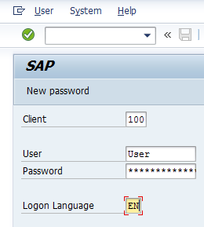
III. Introduction to SAP GUI Login
To login to an SAP system, a client, username and password is needed
The client is an organizational, legal and/or economical entity and has access to the systems data.
User data is saved dependent on the client where you are logged in.

Slide 15
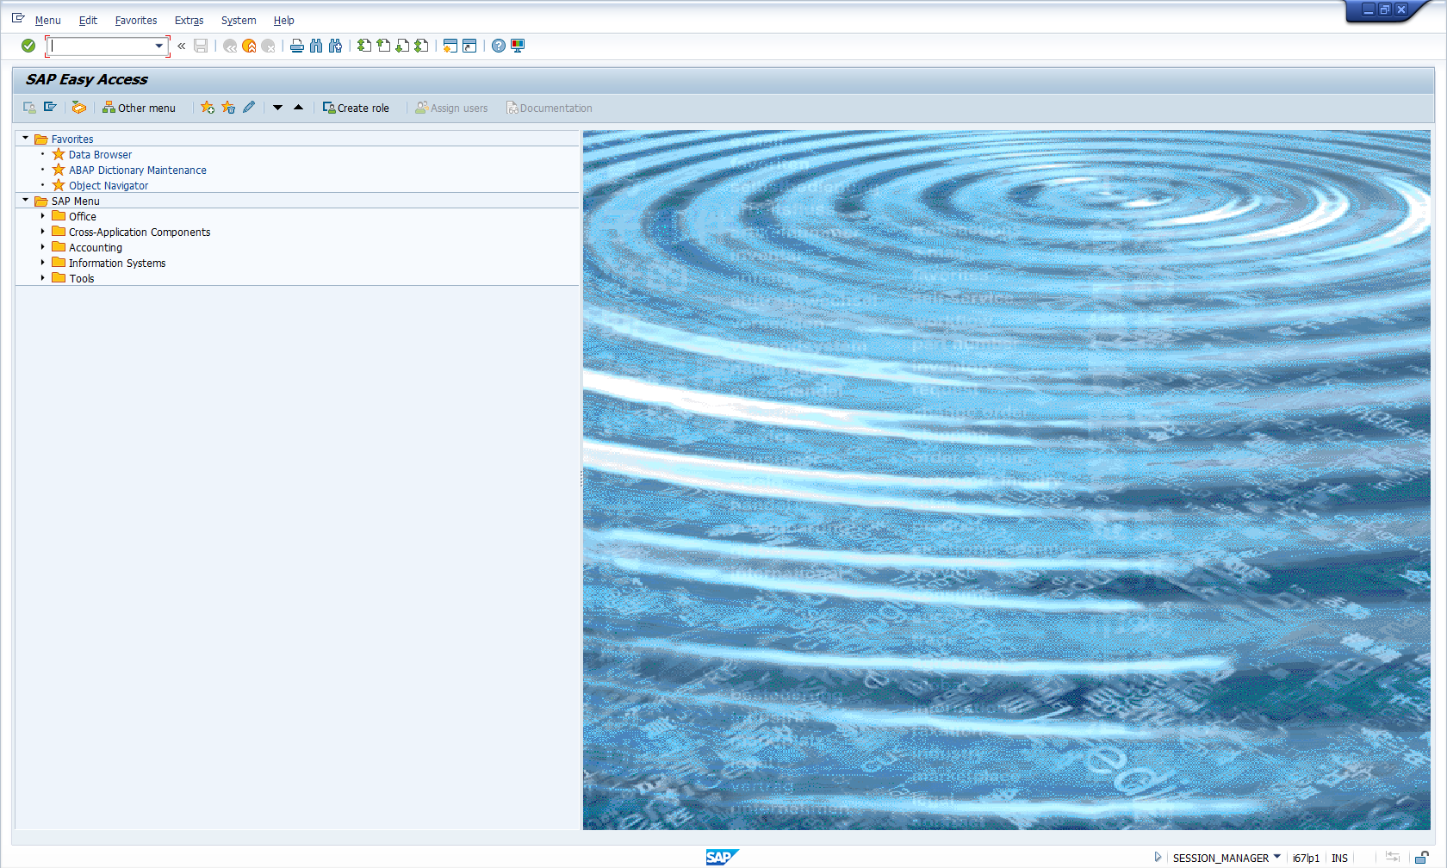
III. Introduction to SAP GUI SAP Easy Access
The entrance screen of the SAP system is the SAP Easy Access menu
The Easy Access menu can be designed individually for a specific role or user

Slide 16
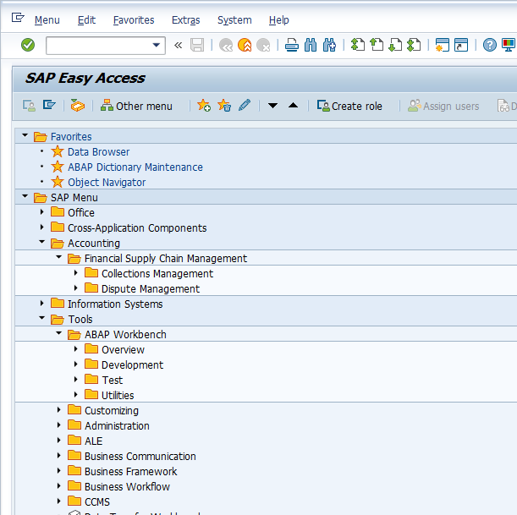
III. Introduction to SAP GUI System functions
Functions can be called in three different ways
Input of transaction codes in the command line (TA-Code)
Entries in Favorite Menu or User Menu
Entries in the Menu Bar
1. Command line
2. Favorite Menu
3. Menu Bar

Slide 17

IV. Introduction to ABAP for Eclipse About Eclipse
SAP decided to enable ABAP application development in the Eclipse platform
Eclipse is a widely used development IDE and the quasi standard for some languages like Java
Eclipse is
open-source
has a plugin based architecture
and a massive developer and end-user base
Source: The Eclipse Foundation (2016)

Slide 18
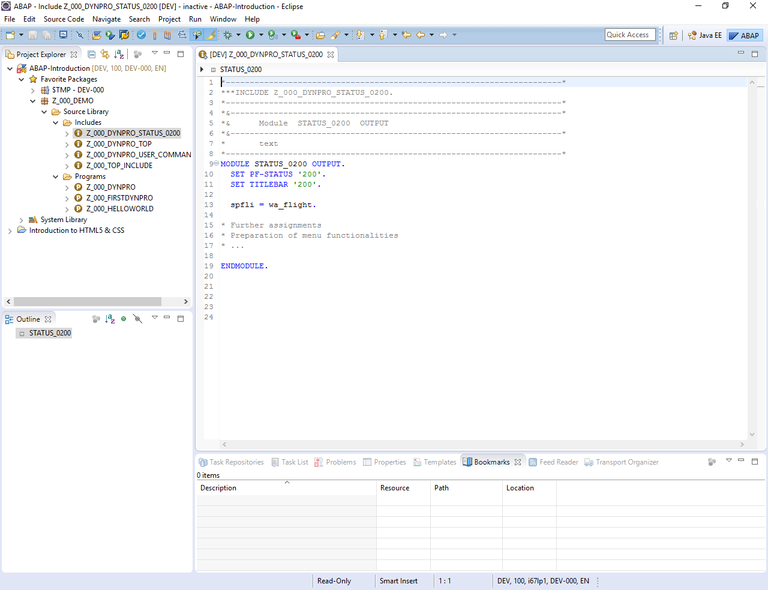
IV. Introduction to ABAP for Eclipse Reasons to use Eclipse
The ABAP Workbench within the SAP GUI is the main tool to develop ABAP applications
It is a very powerful tool, but restrained by its historical and technological roots
Eclipse is more modern and has nice usability features
ABAP is more and more used in conjunction with different languages and technologies (e.g. JavaScript with SAPUI5)
Benefit from HTML editor and code completion for ABAP and JavaScript
Eclipse is still compatible with the existing SAP GUI

Slide 19
IV. Introduction to ABAP for Eclipse Technical features and prerequisites
ABAP code is completely developed online, i.e. on the server
However, program code can be developed offline in Eclipse
Eclipse needs a connection to the SAP system to pull the program code to Eclipse and push it back to the SAP system after saving it
ABAP in Eclipse is delivered as an additional Eclipse plugin
Prerequisites for development:
Eclipse IDE
SAP GUI for Windows
Java Runtime Environment
SAP system access data

Slide 20
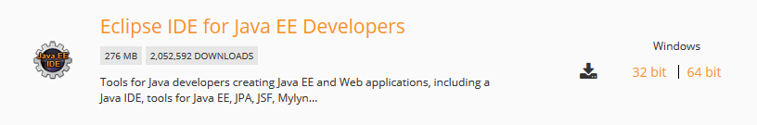
V. Setting up the development environment Step 1: Download Eclipse IDE
Check if you have a current Java Runtime Environment installed
Go to https://eclipse.org/downloads/packages
Download a current version of the Eclipse IDE, we recommend the Oxygen release
Choose Eclipse IDE for Java EE Developers as version
Download and unzip the package to a preferred folder
Start Eclipse
Depending on your installed JRE (Java Runtime Environment) decide the version of your Eclipse IDE.

Slide 21
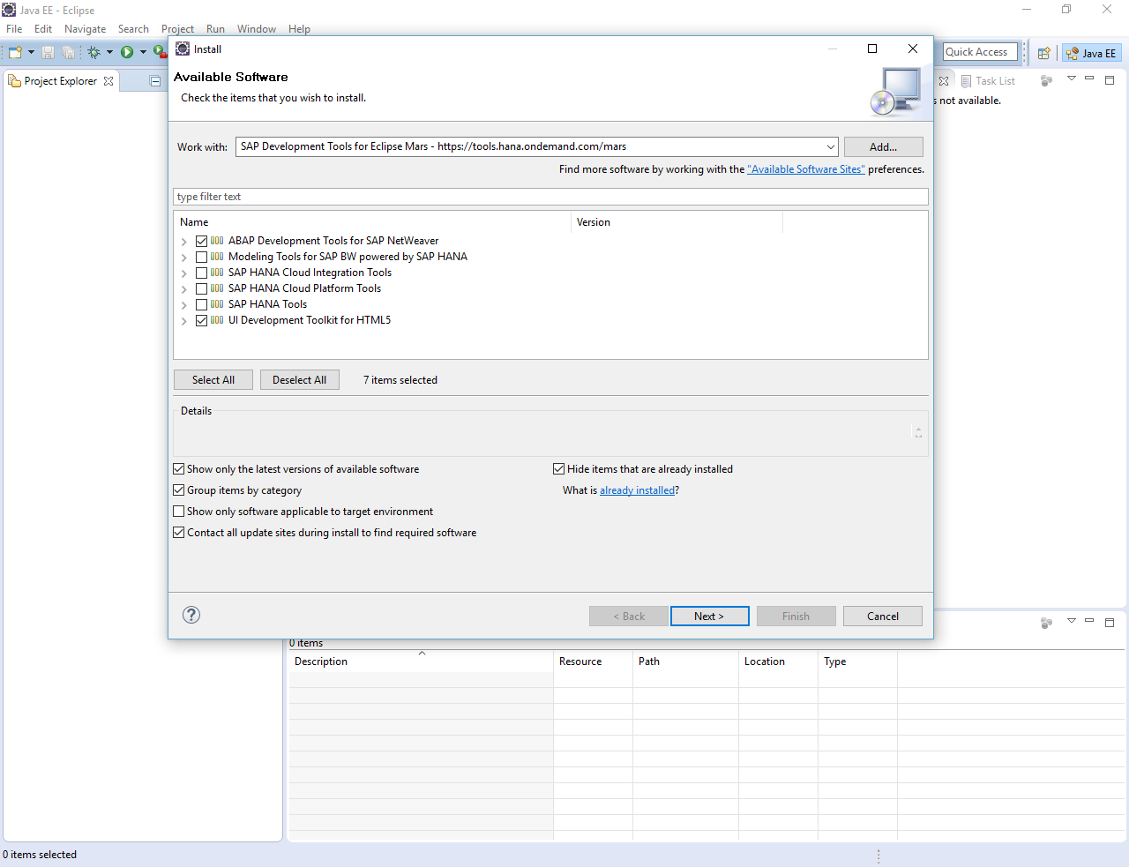
V. Setting up the development environment Step 2: Install ABAP Plugin for Eclipse
In the menu bar, choose Help->Install New Software
Insert the link https://tools.hana.ondemand.com/oxygen (dependent on your Eclipse version)
Choose ABAP and UI Development Tools
Install the plugins

Slide 22
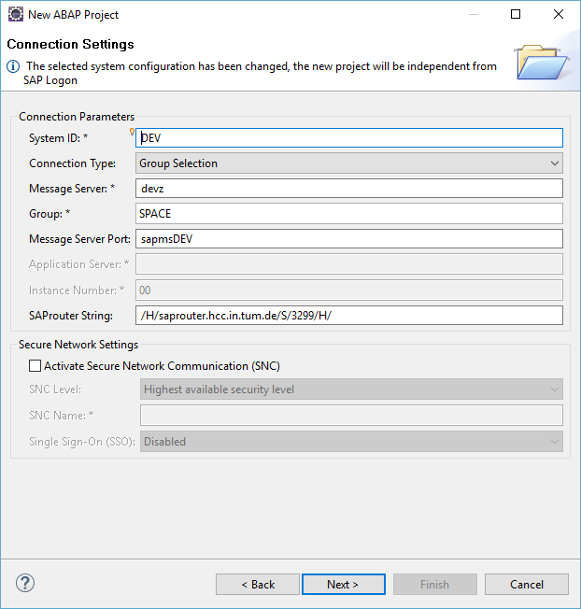
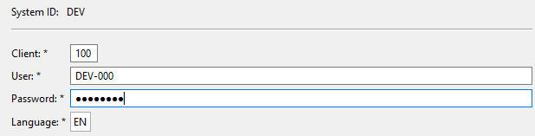
V. Setting up the development environment Step 3: Connect to an SAP System
Go to Window->Perspective->Open Perspective and open the ABAP perspective
Go to File->New->Other->ABAP->ABAP Project
Define the connection settings
Login with your client, username, and password

Slide 23
Now you know the basics about the Eclipse Development Environment and how it can be used for SAP application development.
To consolidate your knowledge, you can do tasks 1 to 5 of the Introduction to SAP Programming exercise.

Slide 24
Check your knowledge

Slide 25
Check your knowledge
What is the difference between BSP, Web Dynpro, and SAPUI5?
What are reasons to use Eclipse instead of the ABAP Workbench to develop applications with SAP?
Which steps have to be processed to install ABAP for Eclipse?
□ Download and install Eclipse for ABAP development
□ Download a standard Eclipse version
□ Install an additional ABAP plugin for Eclipse

Slide 26
Solution

Slide 27
Solution
What is the difference between BSP, Web Dynpro, and SAPUI5?
See section application program types
What are reasons to use Eclipse instead of the ABAP Workbench to develop applications with SAP?
See section Introduction to ABAP for Eclipse
Which steps have to be processed to install ABAP for Eclipse?
□ Download and install Eclipse for ABAP development
☒ Download a standard Eclipse version
☒ Install an additional ABAP plugin for Eclipse

Slide 28
References
The Eclipse Foundation (2016): Eclipse Logos. Retrieved from https://eclipse.org/artwork/.

